Slide 1
N. Rizk
COSC 3337 : Data Science I
College of Natural and Applied Sciences
Department of Computer Science
University of Houston

Slide 2
Terminology
Analyzing data has a long history!
There have been many terms that have been used to describe such endeavors:
Statistics
Artificial Intelligence
Machine learning
Data analytics

Slide 3
The Good
Experiments, observations, and numerical simulations in many areas of science and business are currently generating terabytes of data, and in some cases are on the verge of generating petabytes and beyond. Analyses of the information contained in these data sets have already led to major breakthroughs in fields ranging from genomics to astronomy and high-energy physics and to the development of new information-based industries.
- Frontiers in Massive Data Analysis, National Research Council of the National Academies
The Bad
Given a large mass of data, we can by judicious selection construct perfectly plausible unassailable theories—all of which, some of which, or none of which may be right.
- Paul Arnold Srere

Slide 4
The Hopeful
The ability to take data—to be able to understand it, to process it, to extract value from it, to visualize it, to communicate it—that’s going to be a hugely important skill in the next decades, not only at the professional level but even at the educational level for elementary school kids, for high school kids, for college kids. Because now we really do have essentially free and ubiquitous data. So the complimentary scarce factor is the ability to understand that data and extract value from it.
- Hal Varian, Google's Chief Economist, http://www.mckinsey.com/insights/innovation/hal_varian_on_how_the_web_challenges_managers
My personal goal: Getting students to be able to
think critically about data.

Slide 5

Human beings are really good at pattern detection...

Slide 6
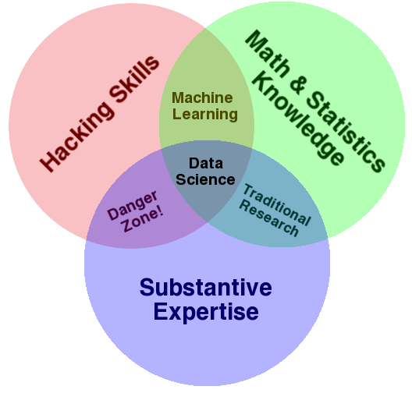
Skills for Data Science
Data science is the field that joins statistics and programming skills in applied settings
Data science qualities
ability to take unstructured data and find order ,value and meaning
Data science is the analysis of diverse data
The demand is because they give insights in what is going on in people minds

Slide 7
Which is most important?
Coding + retrieve and manipulate data
Make sense of data
Gather and prepare data
Unusual data format
Creativity skills
Choose procedure to
Answer question
How to diagnose problem
How to develop and improve procedures to deal with new data challenges
Familiarity with applied domain
To know value , goals and
restrictions of a specific domain

Slide 8
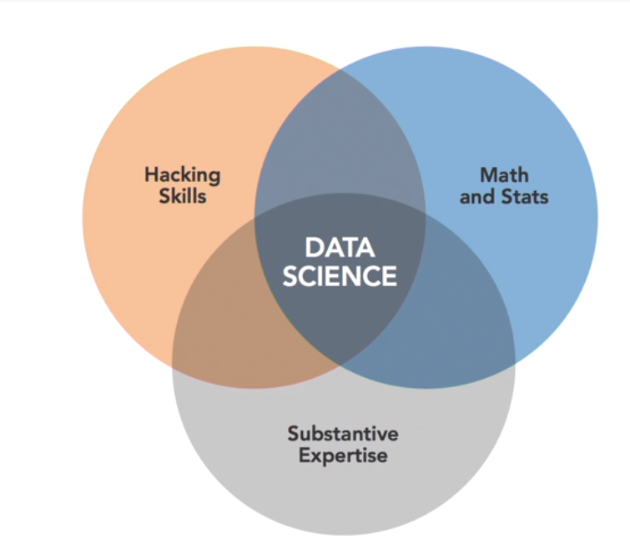
Black box predictive model
Machine
learning
Danger zone
Traditional
research
Unlikely to happen as this person can develop math and statistics expertise
Data sets and analysis
are structured

Slide 9
Role of a data scientist?diverse skills ?Background ?Emphasis
How to do collaborative project in data science?
1- planning
2-data preparation
3-modeling
4-follow up

Slide 10
1-planning tasks
a. Deifne goals
b. Organize resources (+time)
c. Coordinate people
d. Schedule the project

Slide 11
2-data preparation tasks
a. Get data
b. Clean data
c. Explore data
d. Refine data (choice of cases obsverved)

Slide 12
3- modeling tasks (data analysis)
a. Create model
b. Validate model (accurate ?generalize well)
c. Evaluate model (how accurate and informative)
d. Refine data (?tweaks to make more informative and implementable)

Slide 13
4- follow up tasks
a. present model
b. deploy model
c. Revisit model
d. Archive assets (all the steps)

Slide 14
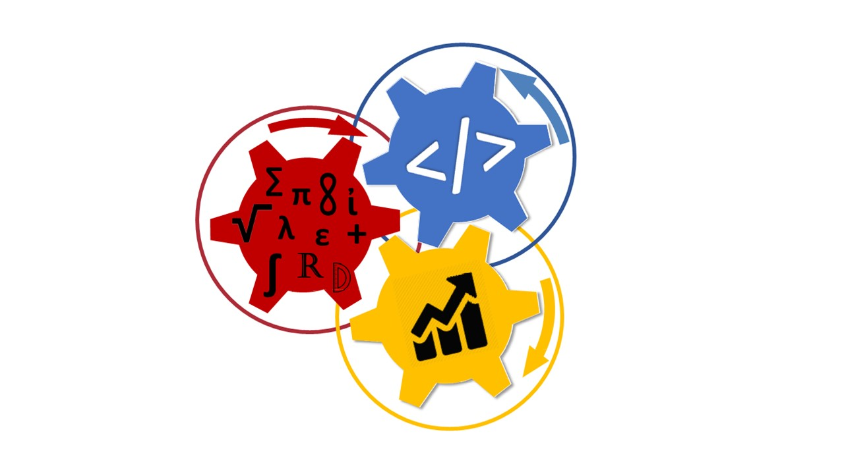
Data Science A Collaboration
Technicians who do data science??
Computer
Science
Mathematics
Business
Contextually oriented managers who puts results into practice

Slide 15
Conclusion what is data science?
Data science is not technical
Contextual skills are critical
Data science fosters diversity

Slide 16
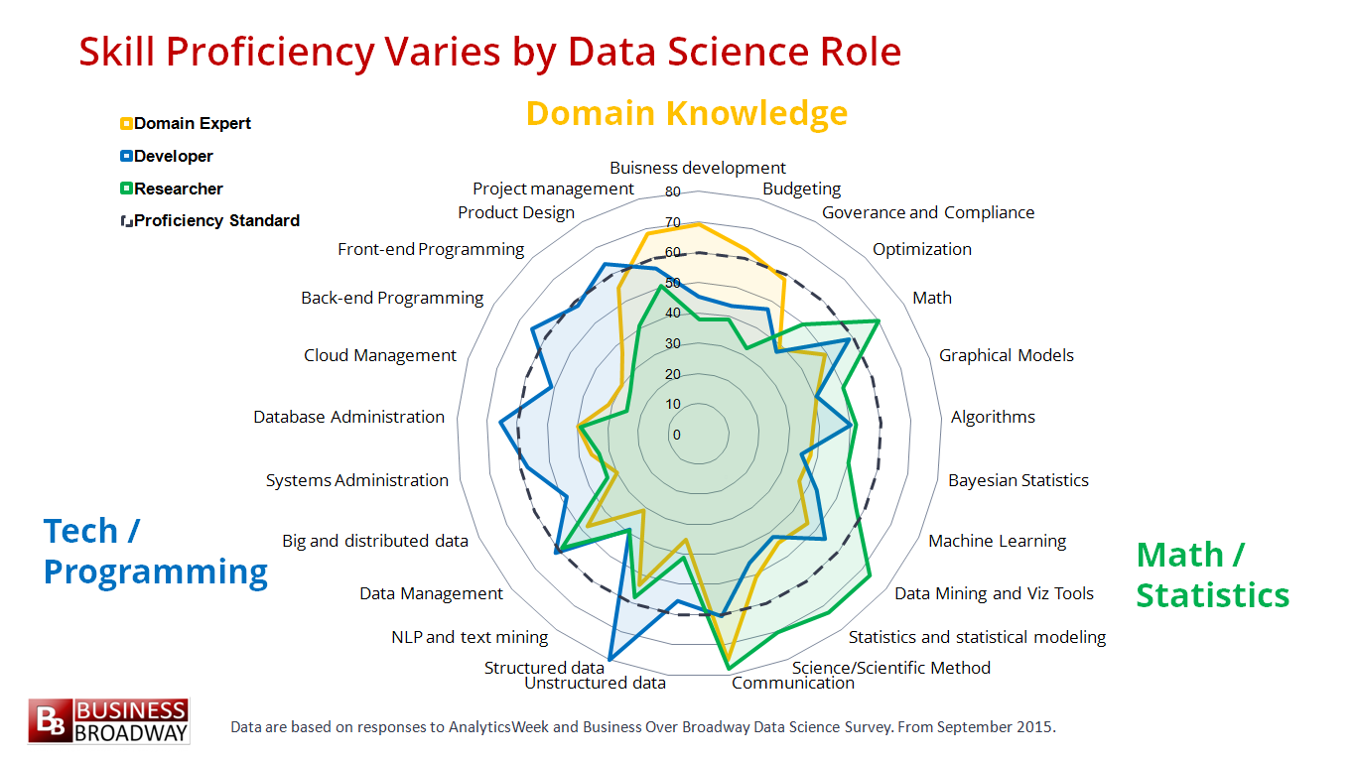

Slide 17
Diverse roles, different goals & skills, different contexts
Engineer/ developer : hardware software
(data engineer , database administrator)
Big data specialist (cs+math =>machine learning)
Researcher (+statistics expertise)
Analyst (day-to-day web analytics, sql, visualizations)
Executive business :manage project o implement solutions
Entrepreneur data based startups,planning , solutions
Full stack data scientist ALL EXPERTISE (Unicorn)

Slide 18
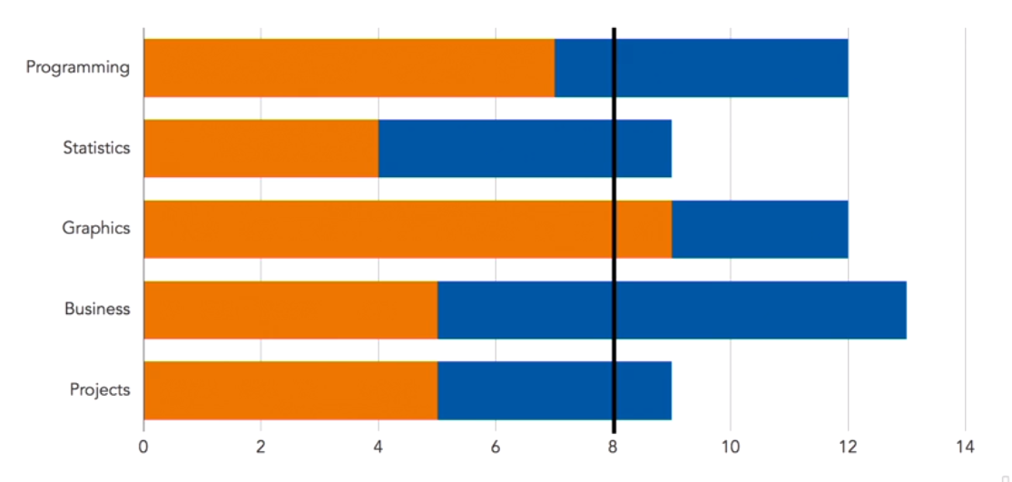
Combined Skills

Slide 19
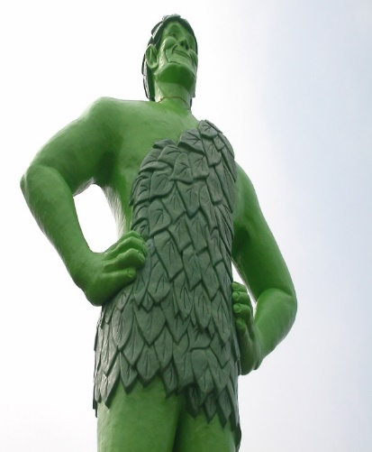
What is Big Data?
The are many examples of "data", but what makes some of it “big”? The classic definition revolves around the three Vs.
Volume, velocity, and variety.
Volume: There is a just a lot of it being generated all the time. Things get interesting and “big”, when you can’t fit it all on one computer anymore. Why? There are many ideas here such as MapReduce, Hadoop, etc. that all revolve around being able to process data that goes from Terabytes, to Petabytes, to Exabytes.
Velocity: Data is being generated very quickly. Can you even store? If not, then what do you get rid of and what do you keep? it all
Variety: The data types you mention all take different shapes. What does it mean to store them so that you can play with or compare them?
http://pl.wikipedia.org/wiki/Green_Giant#mediaviewer/Plik:Jolly_green_giant.jpg

Slide 20
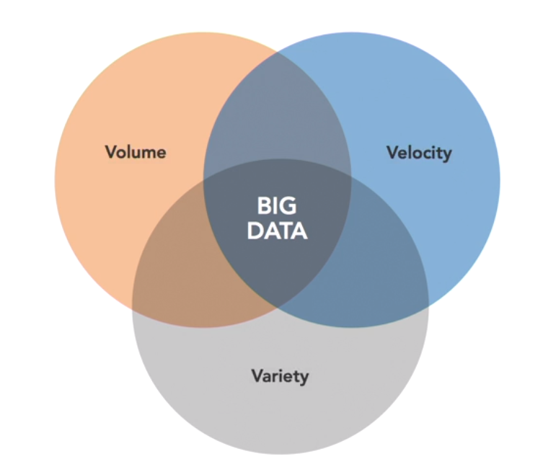
3 V’s
Use MapReduce, Hadoop,
Data is being generated very quickly
data types of different shapes.

Slide 21
Is Big Data the same as Data Science?
Are Big Data and Data Science the same thing?
Data Science can be done on small data sets.
And not everything done using Big Data would necessarily be called Data Science.
Big Data
Data
Science

Slide 22
Is Big Data the same as Data Science?
Are Big Data and Data Science the same thing?
Data Science can be done on small data sets.
And not everything done using Big Data would necessarily be called Data Science.
But there certainly is a substantial overlap!
Big Data
Data
Science

Slide 23
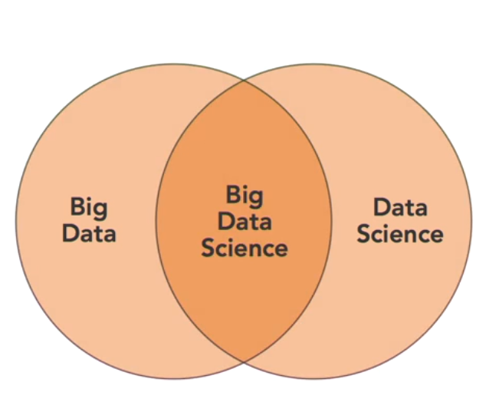
Differ but share same goals and techniques
Data science without Big data
Genetic data sets (huge data sets but consistent)
Streaming sensor data (large +structured)
Facial recognition (variety +small amount photos)
Big data without data science
➔machine learning & words count (+volume or velocity –Math's skills)
Big data science
Volume +velocity +variety
➔Unicorn needed of course

Slide 24
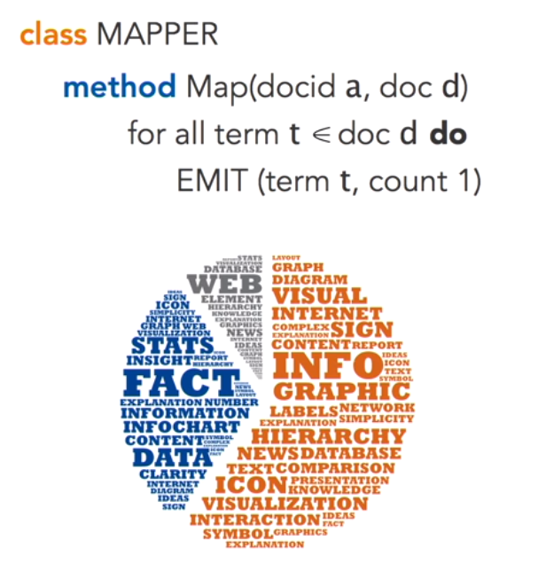
Programming for data (word counts)
Frequency of each set of words?
But data with uncertainty and variability needs Data Science &stats

Slide 25
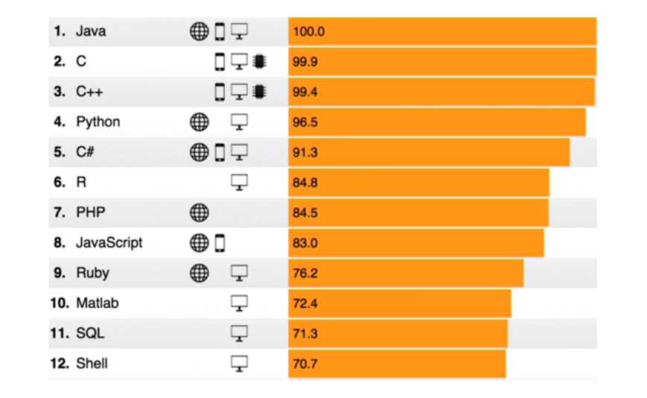
Programming tools

Slide 26
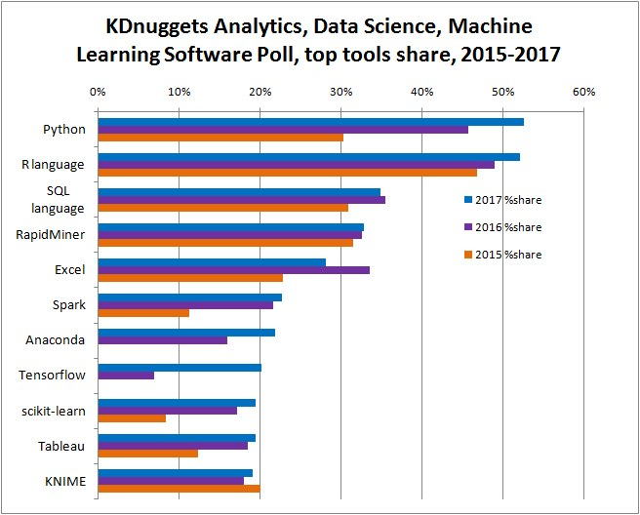
Tools for data science

Slide 27
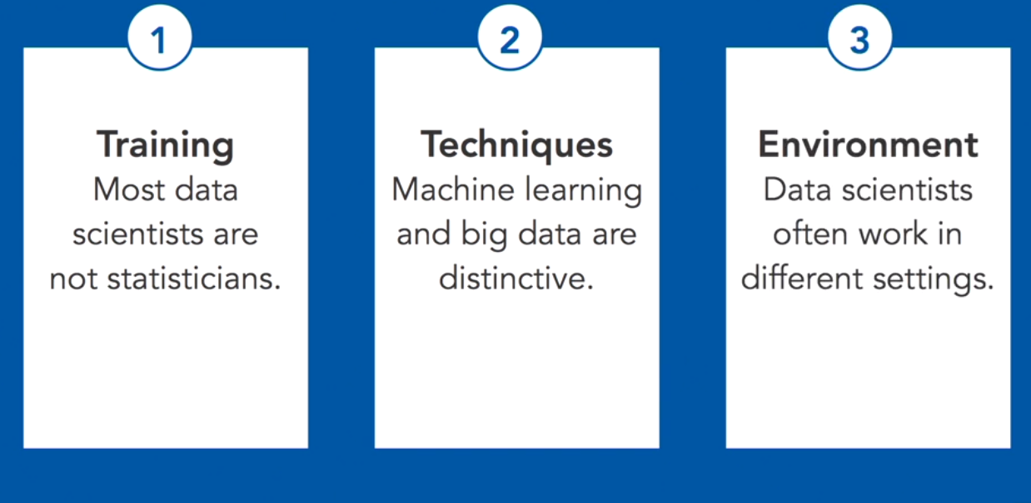
Data science vs statistics
Data science requires statistics but is not a subset
Both fields use data but have different motivation and goals; different background and different context

Slide 28
Measure !!
Measurement boosts awareness
Awareness contribute to quality
Measure thoughtfully and sensitively

Slide 29
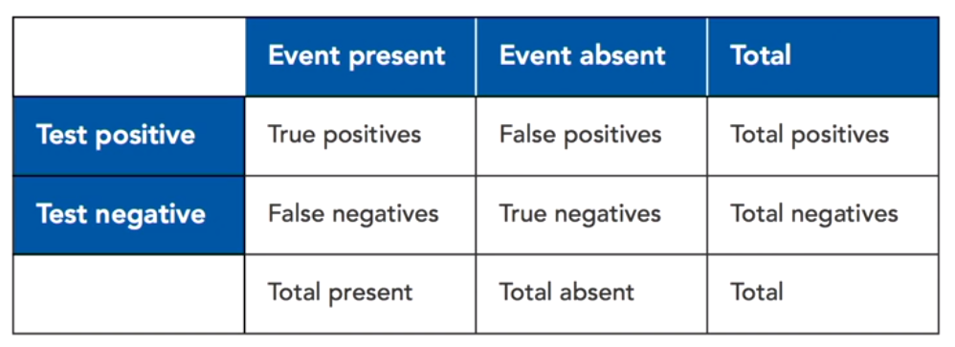
Data science metrics
Key performance Indicators KPIs
(nonfinancial, timely, simple, significant impact)
SMART goals (specific, measurable, assignable, realistic, and time-bound)
Classification accuracy (sensitivity (event exists?),specifity (avoid false negative),positive predictive value, negative predictive value

Slide 30
Existing data sets: care while interpreting data
In house data
Quick easy and free , formatted, identifiers might be available
Cons: non existent data , inadequate documentation, biases answers
Open data: enormous data, formatted, documented, biases or unclear data,
Third party data :Data as a service DaaS,data brokers, processed data , individual level data, can be very expensive , requires validation

Slide 31
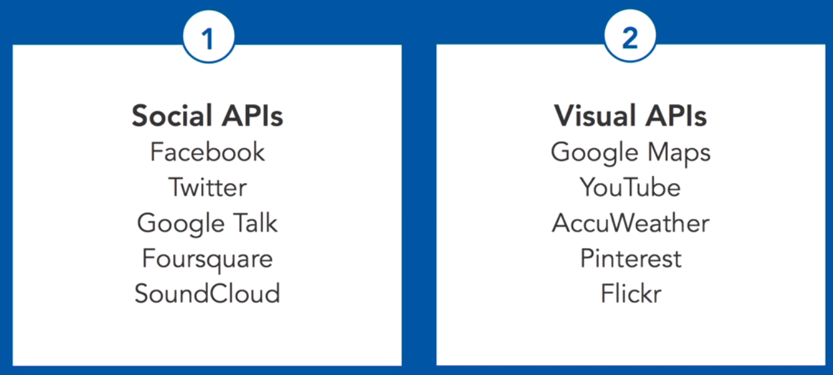
Gather data (API)
APIs:Application programing interface
Rest API: Representation state Transfer API(software architecture style of World web):send via HTTp ; send directly from web to program(javascript,JSON); language agnostic

Slide 32
Access data from the web and feed it into Python
#Import the modules
import requests
import json
# Get the feed
r =requests.get("http://gdata.youtube.com/feeds/api/standardfeeds/top_rated?v=2&alt=jsonc")
r.text
# Convert it to a Python dictionary
data = json.loads(r.text)
# Loop through the result.
for item in data['data']['items']:
print "Video Title: %s" % (item['title'])
print "Video Category: %s" % (item['category'])
print "Video ID: %s" % (item['id'])
print "Video Rating: %f" % (item['rating'])
print "Embed URL: %s" % (item['player']['default'])

Slide 33
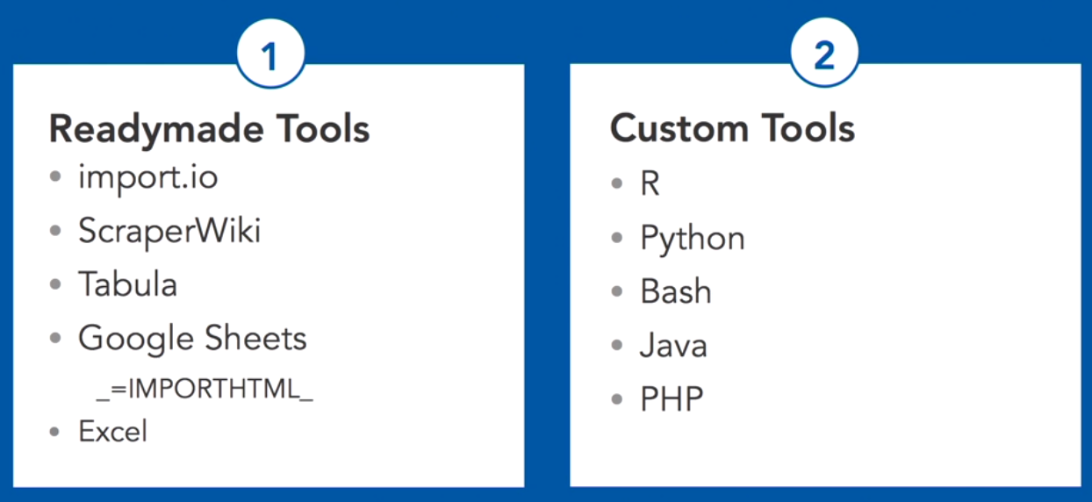
Gather data (scraping data when API does not exist)

Slide 34
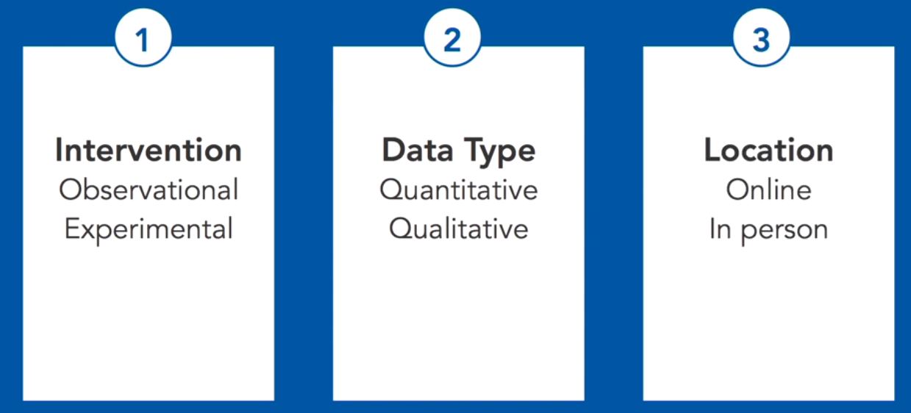
Creating data
Interviews (time consuming), surveys (easy ), card sorting, experiments,
Training

Slide 35
Exploratory graphs
Review data
Check assumptions
Check anomalies
Data suggestion
Quickly check shape, gap, outliers
==========
Bar chart for categories
Box plots for quantitative variable
Histograms (overlay shapes for comparison)
Scatter plot matrices

Slide 36
Exploration: a critical first step in analysis
Single distributions
Joint distributions (associations)
Unusual cases
Error in the data
Missing data

Slide 37
Exploration using
Coding (R, python, JavaScript)
Applications (tableau, Qlik , excel)
By hand (as John Tukey: Exploratory Data Analysis)

Slide 38
Exploratory statistics
Robust statistics:(stable, less affected by outliers, many choices: median, avg..; not easy)
Resample data: empirical estimate of sampling variability
(jackknife:sample without replacement; bootstrap samples with replacement;permutation:shuffle across different group,cross-validation:test/training)
Transform data (functions while preserving the order ..such as Tukey’s ladder of power used when we expect outliers

Slide 39
Programing
Excel flexible
R language (7000 packages CRAN)
Python (Jupyter Interface)
SQL (RDBS)
Web formats (html,xml,Json (javascript object notation),javascript (d3.js library that generates dynamic visualization that can be shared on the web)

Slide 40
What do you need to be ready?
Anaconda - Scientific Python package with IPython Notebook.
https://www.continuum.io/downloads

